Slide 1
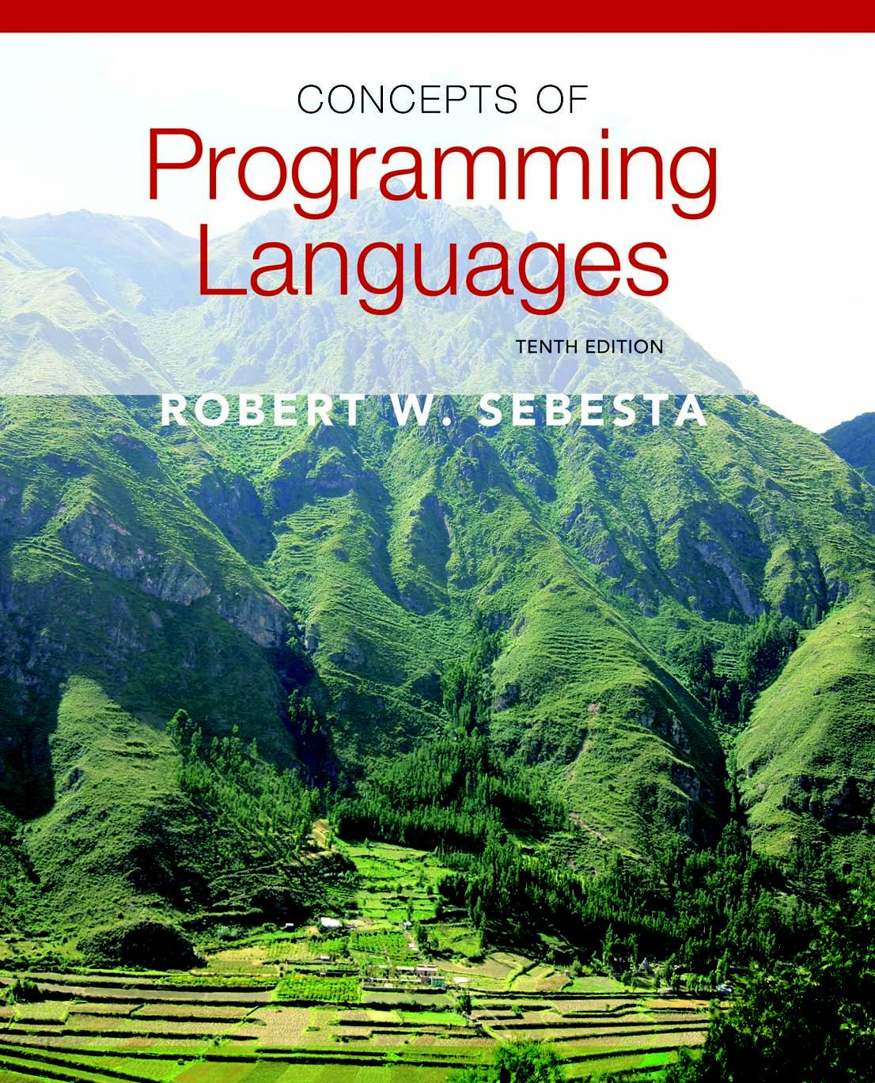
Copyright © 2012 Addison-Wesley. All rights reserved.

Slide 2
Lecture 8: Support for Object-Oriented Programming
CS4080
(Chapters 11&12)

Slide 3
Main Topics
Introduction
Object Oriented Concepts
Data abstraction
Inheritance
Polymorphism
Support for Object-Oriented Programming in Languages including C++, Java, C#, …

Slide 4
Introduction
Many object-oriented programming (OOP) languages
Some support procedural and data-oriented programming (e.g., Ada 95 and C++)
Some support functional program (e.g., CLOS)
Newer languages do not support other paradigms but use their imperative structures (e.g., Java and C#)
Some are pure OOP language (e.g., Smalltalk & Ruby)

Slide 5
Object-Oriented Programming
Exclusivity of Objects
Everything is object
Object allocation, de-allocation, initialization
Abstract data types (ADTs)
For example: classes in C++, Java, …
Inheritance
Inheritance is the central theme in OOP and languages that support it
Polymorphism
For example, virtual functions in C++, …

Slide 6
Allocation and DeAllocation of Objects
From where are objects allocated?
If they behave like the ADTs, they can be allocated from anywhere
Allocated from the run-time stack
Explicitly create on the heap (e.g. via new in C++)
If they are all heap-dynamic, references can be uniform thru a pointer or reference variable
Simplifies assignment - dereferencing can be implicit
If objects are stack dynamic, there is a problem with regard to subtypes
Is deallocation explicit or implicit?

Slide 7
Initialization of Objects
Are objects initialized to values when they are created?
Implicit or explicit initialization
How are parent class members initialized when a subclass object is created?

Slide 8
The Concept of Abstraction
An abstraction is a view or representation of an entity that includes only the most significant attributes
The concept of abstraction is fundamental in programming (and computer science)
Nearly all programming languages support process abstraction with subprograms
Nearly all programming languages designed since 1980 support data abstraction

Slide 9
Introduction to Data Abstraction
An abstract data type (ADT) is a user-defined data type that satisfies the following two conditions:
The representation of, and operations on, objects of the type are defined in a single syntactic unit
The representation of objects of the type is hidden from the program units that use these objects, so the only operations possible are those provided in the type's definition

Slide 10
Language Requirements for ADTs
A syntactic unit in which to encapsulate the type definition
A method of making type names and subprogram headers visible to clients, while hiding actual definitions
Some primitive operations must be built into the language processor

Slide 11
Language Examples: C++
Based on C struct type and Simula 67 classes
The class is the encapsulation device
All of the class instances of a class share a single copy of the member functions
Each instance of a class has its own copy of the class data members
Instances can be static, stack dynamic, or heap dynamic

Slide 12
Language Examples: C++ (continued)
Information Hiding
Private clause for hidden entities
Public clause for interface entities
Protected clause for inheritance

Slide 13
Language Examples: C++ (continued)
Constructors:
Functions to initialize the data members of instances (they do not create the objects)
May also allocate storage if part of the object is heap-dynamic
Can include parameters to provide parameterization of the objects
Implicitly called when an instance is created
Can be explicitly called
Name is the same as the class name

Slide 14
Language Examples: C++ (continued)
Destructors
Functions to cleanup after an instance is destroyed; usually just to reclaim heap storage
Implicitly called when the object’s lifetime ends
Can be explicitly called
Name is the class name, preceded by a tilde (~)

Slide 15
An Example in C++
class Stack {
private:
int *stackPtr, maxLen, topPtr;
public:
Stack() { // a constructor
stackPtr = new int [100];
maxLen = 99;
topPtr = -1;
};
~Stack () {delete [] stackPtr;};
void push (int num) {…};
void pop () {…};
int top () {…};
int empty () {…};
}

Slide 16
A Stack class header file
// Stack.h - the header file for the Stack class
#include <iostream.h>
class Stack {
private: //** These members are visible only to other
//** members and friends (see Section 11.6.4)
int *stackPtr;
int maxLen;
int topPtr;
public: //** These members are visible to clients
Stack(); //** A constructor
~Stack(); //** A destructor
void push(int);
void pop();
int top();
int empty();
}

Slide 17
The code file for Stack
// Stack.cpp - the implementation file for the Stack class
#include <iostream.h>
#include "Stack.h"
using std::cout;
Stack::Stack() { //** A constructor
stackPtr = new int [100];
maxLen = 99;
topPtr = -1;
}
Stack::~Stack() {delete [] stackPtr;}; //** A destructor
void Stack::push(int number) {
if (topPtr == maxLen)
cerr << "Error in push--stack is full\n";
else stackPtr[++topPtr] = number;
}
...

Slide 18
Language Examples: C++ (continued)
Friend functions or classes - to provide access to private members to some unrelated units or functions
Necessary in C++
Friend functions or classes - to provide access to private members to some unrelated units or functions
Necessary in C++

Slide 19
Language Examples: Java
Similar to C++, except:
All user-defined types are classes
All objects are allocated from the heap and accessed through reference variables
Individual entities in classes have access control modifiers (private or public), rather than clauses
Java has a second scoping mechanism, package scope, which can be used in place of friends
All entities in all classes in a package that do not have access control modifiers are visible throughout the package

Slide 20
An Example in Java
class StackClass {
private int [] stackRef;
private int [] maxLen, topIndex;
public StackClass() { // a constructor
stackRef = new int [100];
maxLen = 99;
topPtr = -1;
};
public void push (int num) {…};
public void pop () {…};
public int top () {…};
public boolean empty () {…};
}

Slide 21
Parameterized ADTs in C++
Classes can be somewhat generic by writing parameterized constructor functions
class Stack {
…
Stack (int size) {
stk_ptr = new int [size];
max_len = size - 1;
top = -1;
};
…
}
Stack stk(100);

Slide 22
Parameterized ADTs in C++ (continued)
The stack element type can be parameterized by making the class a templated class template <class Type> class Stack { private: Type *stackPtr; const int maxLen; int topPtr; public: Stack() { stackPtr = new Type[100]; maxLen = 99; topPtr = -1; } … }

Slide 23
Parameterized Classes in Java 5.0
Generic parameters must be classes
Most common generic types are the collection types, such as LinkedList and ArrayList
Eliminate the need to cast objects that are removed
Eliminate the problem of having multiple types in a structure

Slide 24
public class Box<T> {
// T stands for "Type"
private T t;
public void set(T t) { this.t = t; }
public T get() { return t; }
}
Box<Integer> integerBox;
//must use Integer wrap class

Slide 25
Encapsulation Constructs
Large programs have two special needs:
Some means of organization, other than simply division into subprograms
Some means of partial compilation (compilation units that are smaller than the whole program)
Obvious solution: a grouping of subprograms that are logically related into a unit that can be separately compiled (compilation units)
Such collections are called encapsulation

Slide 26
Encapsulation in C++
Can define header and code files, similar to those of C
Or, classes can be used for encapsulation
The class is used as the interface (prototypes)
The member definitions are defined in a separate file
Friends provide a way to grant access to private members of a class

Slide 27
C# Assemblies
A collection of files that appears to application programs to be a single dynamic link library or executable
Each file contains a module that can be separately compiled
A DLL is a collection of classes and methods that are individually linked to an executing program
C# has an access modifier called internal; an internal member of a class is visible to all classes in the assembly in which it appears

Slide 28
Naming Encapsulations
Large programs define many global names; need a way to divide into logical groupings
A naming encapsulation is used to create a new scope for names
C++, C#, Java, Ada, and Ruby provide naming encapsulations
C++ Namespaces
Can place each library in its own namespace and qualify names used outside with the namespace
C# also includes namespaces

Slide 29
Naming Encapsulations (continued)
Java Packages
Packages can contain more than one class definition; classes in a package are partial friends
Clients of a package can use fully qualified name or use the import declaration
Ruby classes are name encapsulations, but Ruby also has modules
Ada uses package

Slide 30
Inheritance
Increase in productivity can come from reuse
ADTs are difficult to reuse—always need changes
All ADTs are independent and at the same level
Inheritance allows new classes defined in terms of existing ones, i.e., by allowing them to inherit common parts
Inheritance addresses both of the above concerns--reuse ADTs after minor changes and define classes in a hierarchy

Slide 31
Object-Oriented Concepts
ADTs are usually called classes
Class instances are called objects
A class that inherits is a derived class or a subclass
The class from which another class inherits is a parent class or superclass
Subprograms that define operations on objects are called methods

Slide 32
Access Control and Method Override
Inheritance can be complicated by access controls to encapsulated entities
A class can hide entities from its subclasses
A class can hide entities from its clients
A class can also hide entities for its clients while allowing its subclasses to see them
Besides inheriting methods as is, a class can modify an inherited method
The new one overrides the inherited one
The method in the parent is overriden

Slide 33
Derived/Inherited Classes
Three ways a class can differ from its parent:
1. The parent class can define some of its variables or methods to have private access, which means they will not be visible in the subclass
2. The subclass can add variables and/or methods to those inherited from the parent
3. The subclass can modify the behavior of one or more of its inherited methods.

Slide 34
Single and Multiple Inheritance
Multiple inheritance allows a new class to inherit from two or more classes
Disadvantages of multiple inheritance:
Language and implementation complexity (in part due to name collisions)
Potential inefficiency - dynamic binding costs more with multiple inheritance (but not much)
Advantage:
Sometimes it is quite convenient and valuable

Slide 35
Dynamic Binding
A polymorphic variable can be defined in a class that is able to reference (or point to) objects of the class and objects of any of its descendants
When a class hierarchy includes classes that override methods and such methods are called through a polymorphic variable, the binding to the correct method will be dynamic
Allows software systems to be more easily extended during both development and maintenance

Slide 36
Inheritance in C++
Inheritance
A class need not be the subclass of any class
Access controls for members are
Private (visible only in the class and friends) (disallows subclasses from being subtypes)
Public (visible in subclasses and clients)
Protected (visible in the class and in subclasses, but not clients)
Access control for subclasses
Public derivation
Protected derivation (not commonly used)
Private derivation

Slide 37
Inheritance Example in C++
class base_class {
private:
int a;
float x;
protected:
int b;
float y;
public:
int c;
float z;
};
class subclass_1 : public base_class { … };
// In this one, b and y are protected and
// c and z are public
class subclass_2 : private base_class { … };
// In this one, b, y, c, and z are private,
// and no derived class has access to any
// member of base_class

Slide 38
Scope Resolution in C++
A member that is not accessible in a subclass (because of private derivation) can be declared to be visible there using the scope resolution operator (::), e.g.,
class subclass_3 : private base_class {
base_class :: c;
…
}

Slide 39
More on C++ Inheritance
Multiple inheritance is supported
If there are two inherited members with the same name, they can both be referenced using the scope resolution operator
Dynamic Binding
A method can be defined to be virtual, which means that they can be called through polymorphic variables and dynamically bound to messages
A pure virtual function has no definition at all
A class that has at least one pure virtual function is an abstract class

Slide 40
Inheritance in Java
Inheritance
Single inheritance supported only, but there is an abstract class category that provides some of the benefits of multiple inheritance (interface)
An interface can include only method declarations and named constants, e.g.,
public interface Comparable <T> {
public int comparedTo (T b);
}
Methods can be final (cannot be overriden)

Slide 41
Dynamic Binding in Java
Dynamic Binding
In Java, all messages are dynamically bound to methods, unless the method is final (i.e., it cannot be overriden, therefore dynamic binding serves no purpose)
Static binding is also used if the methods is static or private both of which disallow overriding

Slide 42
Support for OOP in C#
General characteristics
Support for OOP similar to Java
Includes both classes and structs
Classes are similar to Java’s classes
structs are less powerful stack-dynamic constructs (e.g., no inheritance)

Slide 43
Inheritance in C#
Inheritance
Uses the syntax of C++ for defining classes
A method inherited from parent class can be replaced in the derived class by marking its definition with new
The parent class version can still be called explicitly with the prefix base:
base.Draw()

Slide 44
Dynamic Binding in C#
Dynamic binding
To allow dynamic binding of method calls to methods:
The base class method is marked virtual
The corresponding methods in derived classes are marked override
Abstract methods are marked abstract and must be implemented in all subclasses
All C# classes are ultimately derived from a single root class, Object

Slide 45
Support for OOP in C#: Summary
Evaluation
C# is the most recently designed C-based OO language
The differences between C#’s and Java’s support for OOP are relatively minor
Evaluation
C# is the most recently designed C-based OO language
The differences between C#’s and Java’s support for OOP are relatively minor

Slide 46
Summary
OO programming involves three fundamental concepts: ADTs, inheritance, dynamic binding
Major design issues: exclusivity of objects, subclasses and subtypes, type checking and polymorphism, single and multiple inheritance, dynamic binding, explicit and implicit de-allocation of objects, and nested classes
Smalltalk is a pure OOL
C++ has two distinct type system (hybrid)
Java is not a hybrid language like C++; it supports only OO programming

